Slide 1
Joins, Subqueries, and CTEs
Lecturer: Ngo Huy Bien
Software Engineering Department
Faculty of Information Technology
VNUHCM - University of Science
Ho Chi Minh City, Vietnam
nhbien@fit.hcmus.edu.vn

Slide 2

Objectives

Slide 3

Contents

Slide 4

References
Adam Jorgensen et al. (2012). Microsoft SQL Server 2012 Bible. Wiley.

Slide 5
Relational Algebra
Relational databases, by their nature, segment data into several narrow, but long, tables.
Seldom does looking at a single table provide meaningful data. Therefore, merging data from multiple tables is an important task for SQL developers.
The theory behind merging data sets is relational algebra, as defined by E. F. Codd in 1970.
In the formal language of relational algebra:
A table, or data set, is a relation or entity.
A row is a tuple.
A column is an attribute.

Slide 6
Relational Operators
Relational algebra consists of eight relational operators:
Restrict: Returns the rows that meet a certain criterion
Project: Returns selected columns, or calculated data, from a data set
Product: Relational multiplication that returns all possible combinations of data between two data sets
Union: Relational addition and subtraction that merges two tables vertically by stacking one table above another table and lining up the columns
Intersection: Returns the rows common to two data sets
Difference: Returns the rows unique to one data set
Join: Returns the horizontal merger of two tables, matching up rows based on common data
Divide: The inverse of relational multiplication, returns rows in one data set that match every row in a corresponding data set

Slide 7
Subqueries
In addition, as a method to accomplish relational algebra, SQL has implemented the following:
Subqueries: Similar to a join but more flexible; the results of the subquery are used in place of an expression, list, or data set within an outer query.

Slide 8
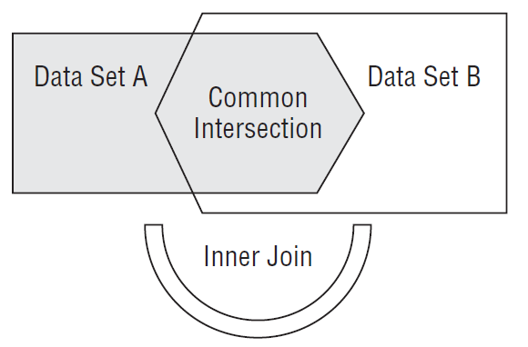
Inner Joins
The inner join includes only those rows from each side of the join that are contained within the intersection of the two data sources.
SELECT *
FROM Table1
[INNER] JOIN Table2
ON Table1.column = Table2.column;

Slide 9
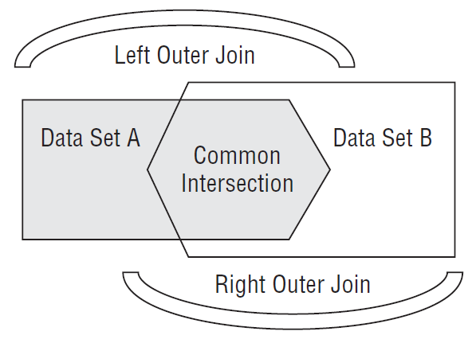
Outer Joins
An outer join includes not only rows from the two data sources with a match, but also unmatched rows from outside the intersection.
SELECT *
FROM Table1
LEFT|RIGHT [OUTER] JOIN Table2
ON Table1.column = Table2.column;

Slide 10
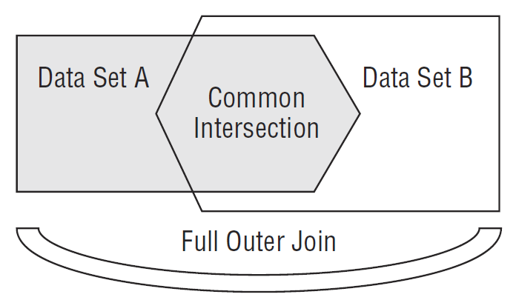
Full Outer Joins
The full outer join returns all the data from both data sets, matching the rows where it can and presenting NULL when it cannot.
SELECT *
FROM Table1
LEFT|RIGHT [OUTER] JOIN Table2
ON Table1.column = Table2.column;

Slide 11


Slide 12
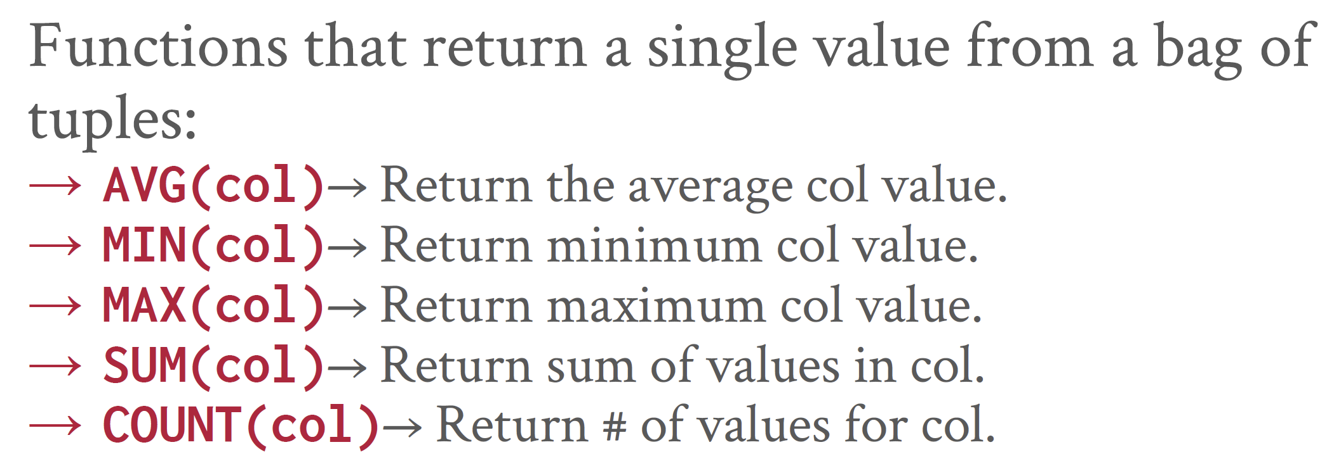
Aggregates

Slide 13
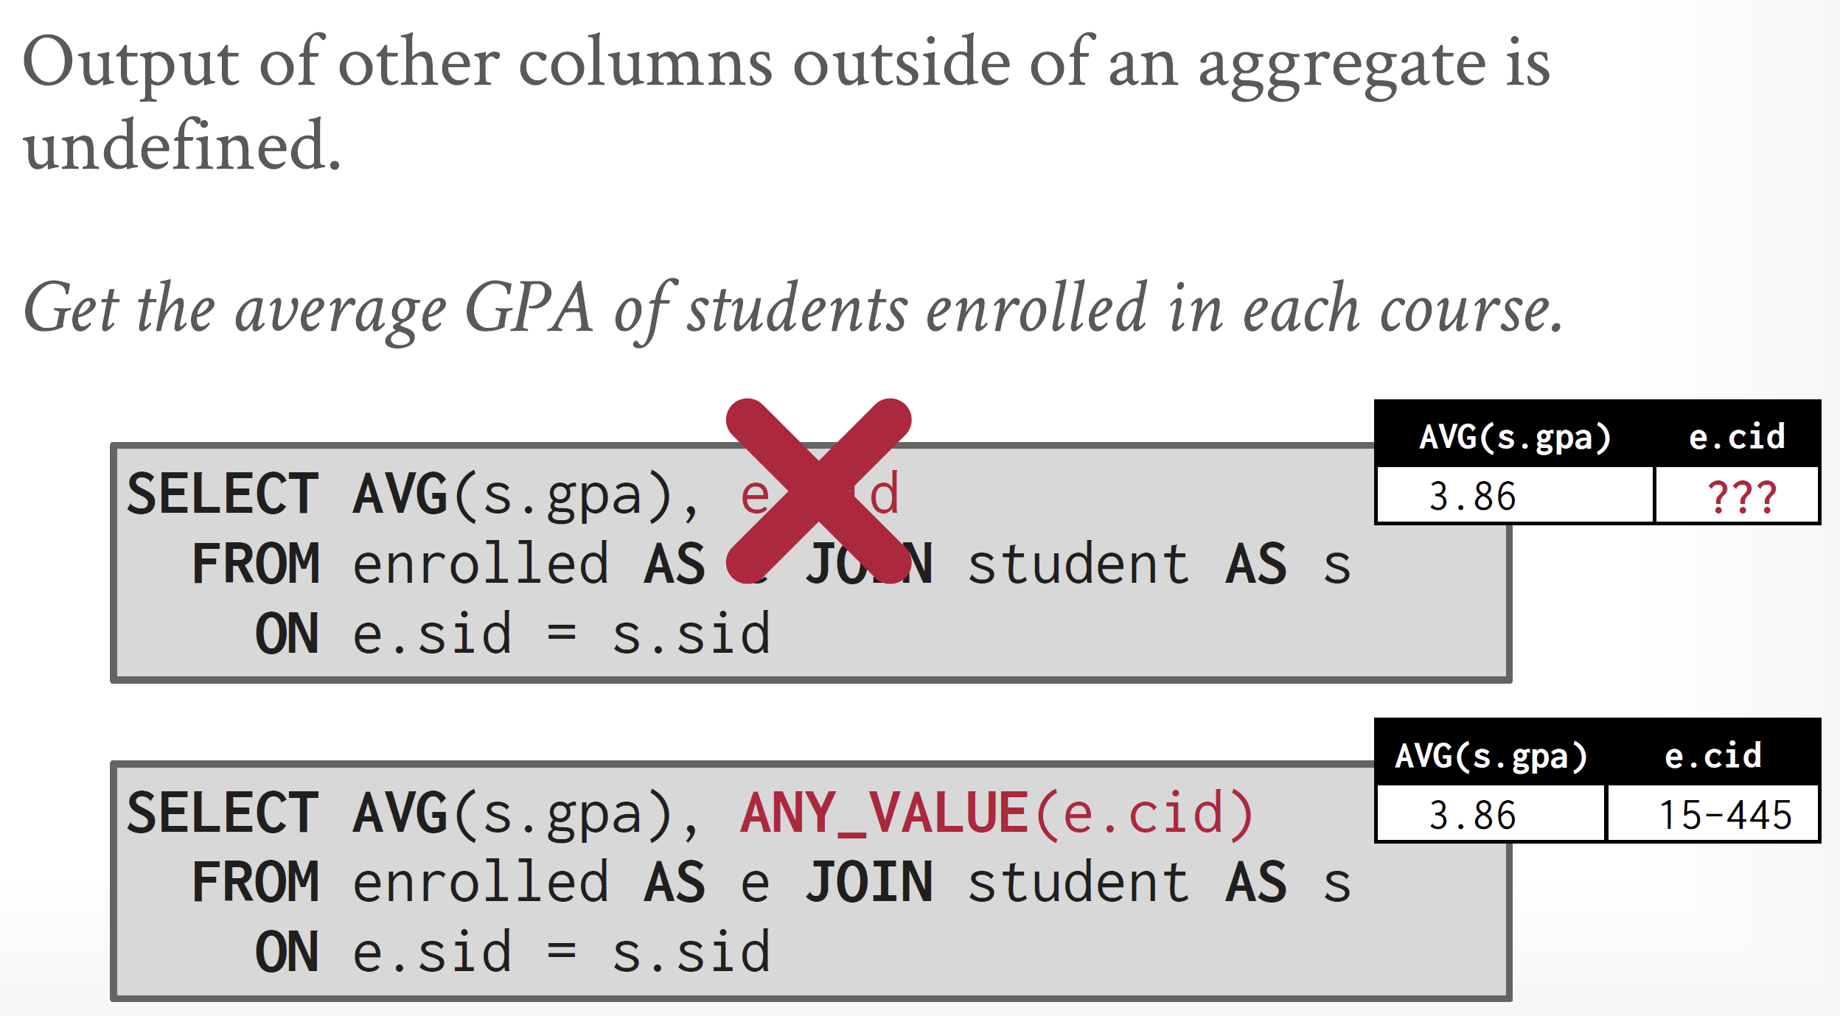
ANY_VALUE

Slide 14
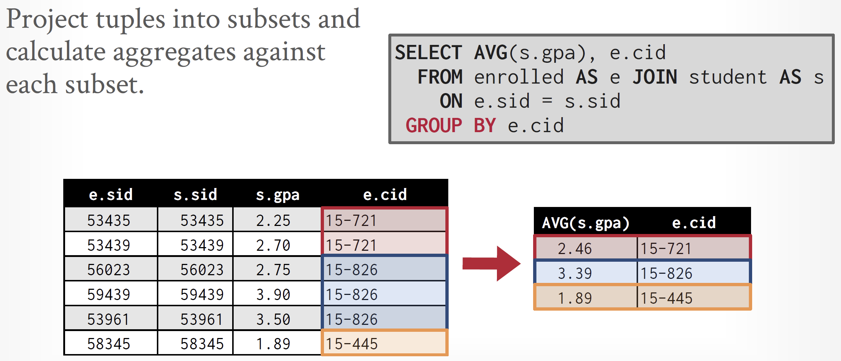
GROUP BY

Slide 15
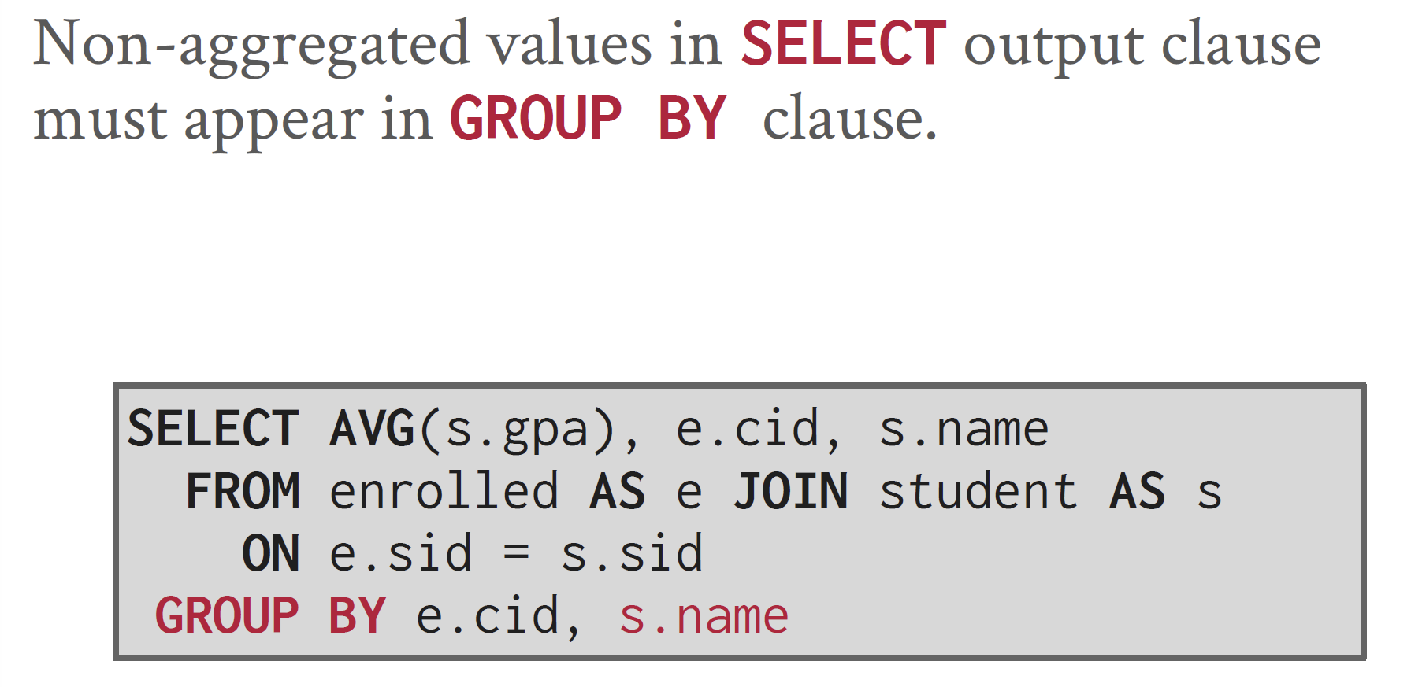
GROUP BY: Non-aggregated Values

Slide 16
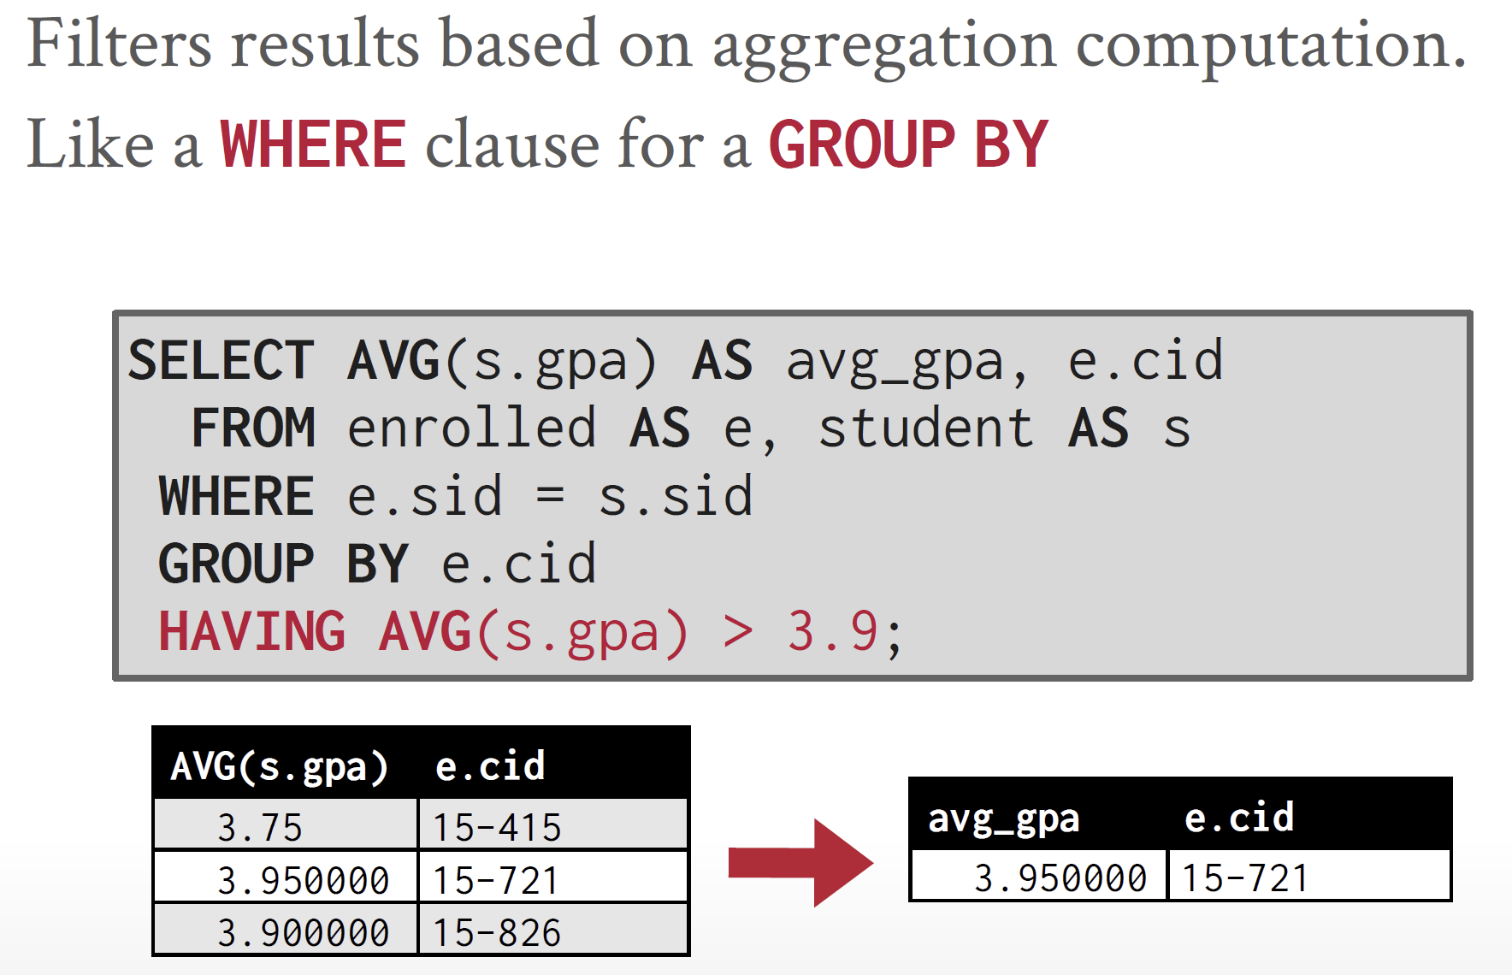
HAVING

Slide 17
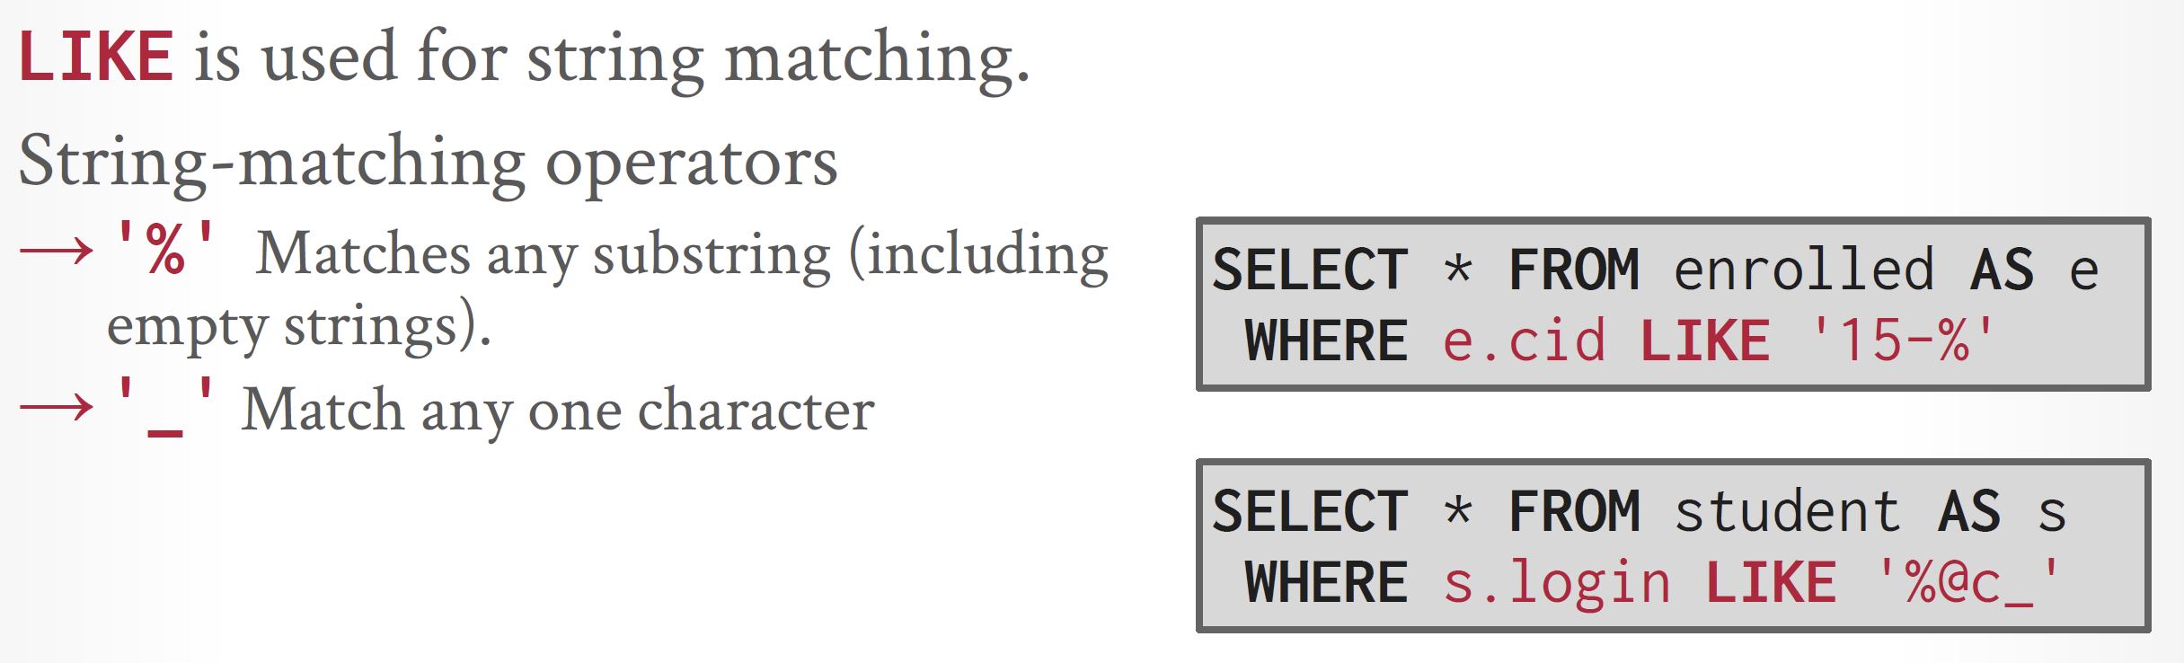
Strings: LIKE

Slide 18
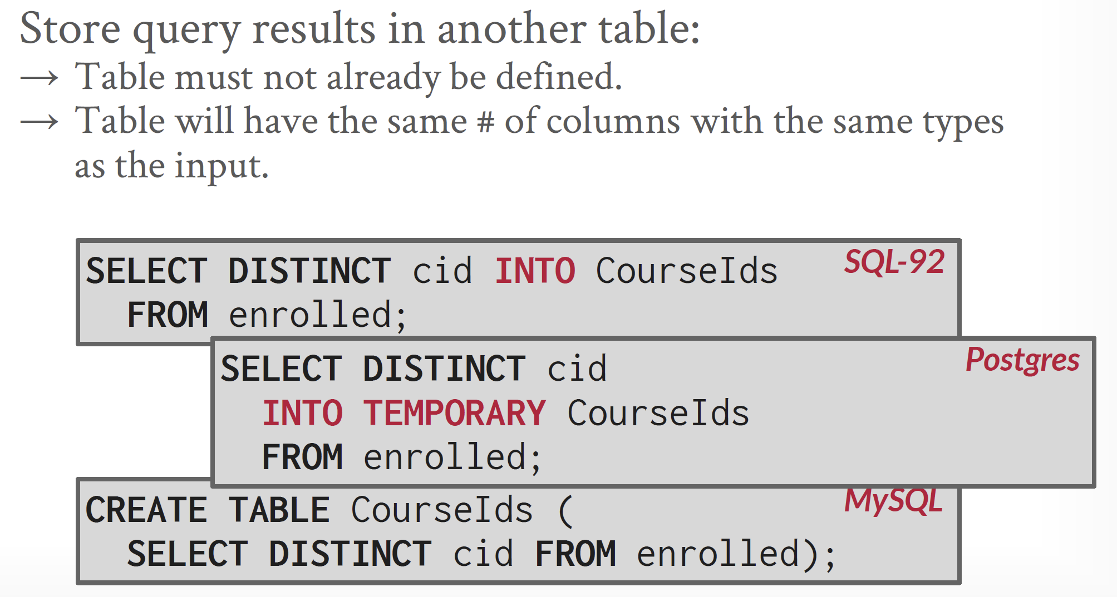
Output Redirection

Slide 19
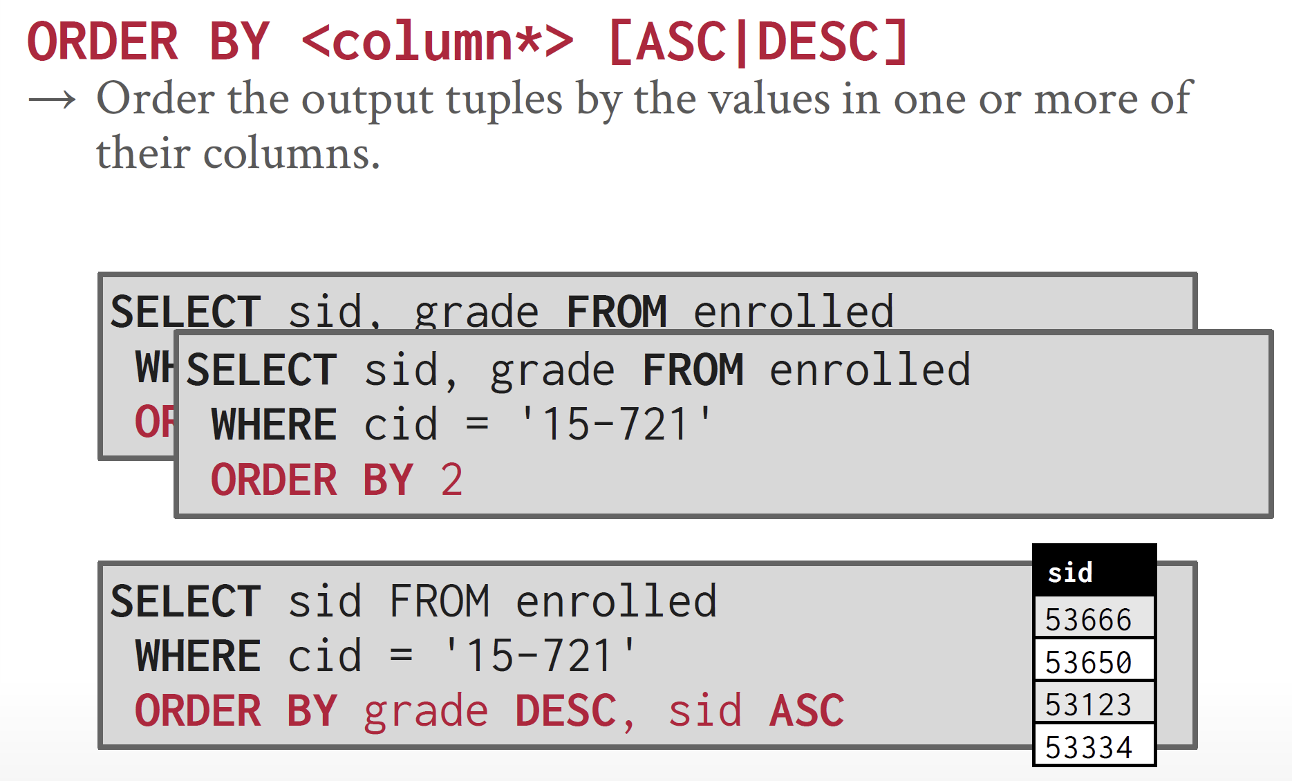
ORDER BY

Slide 20
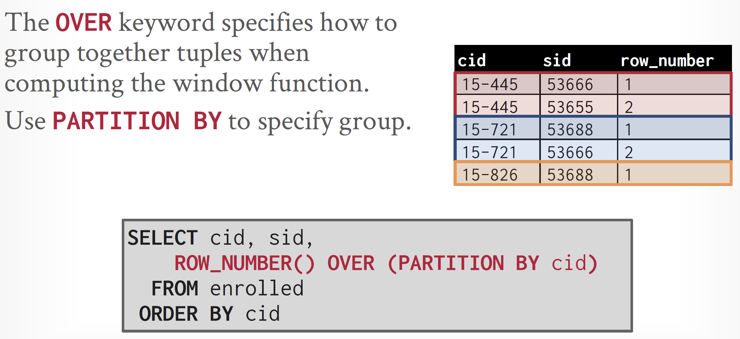
ROW_NUMBER

Slide 21
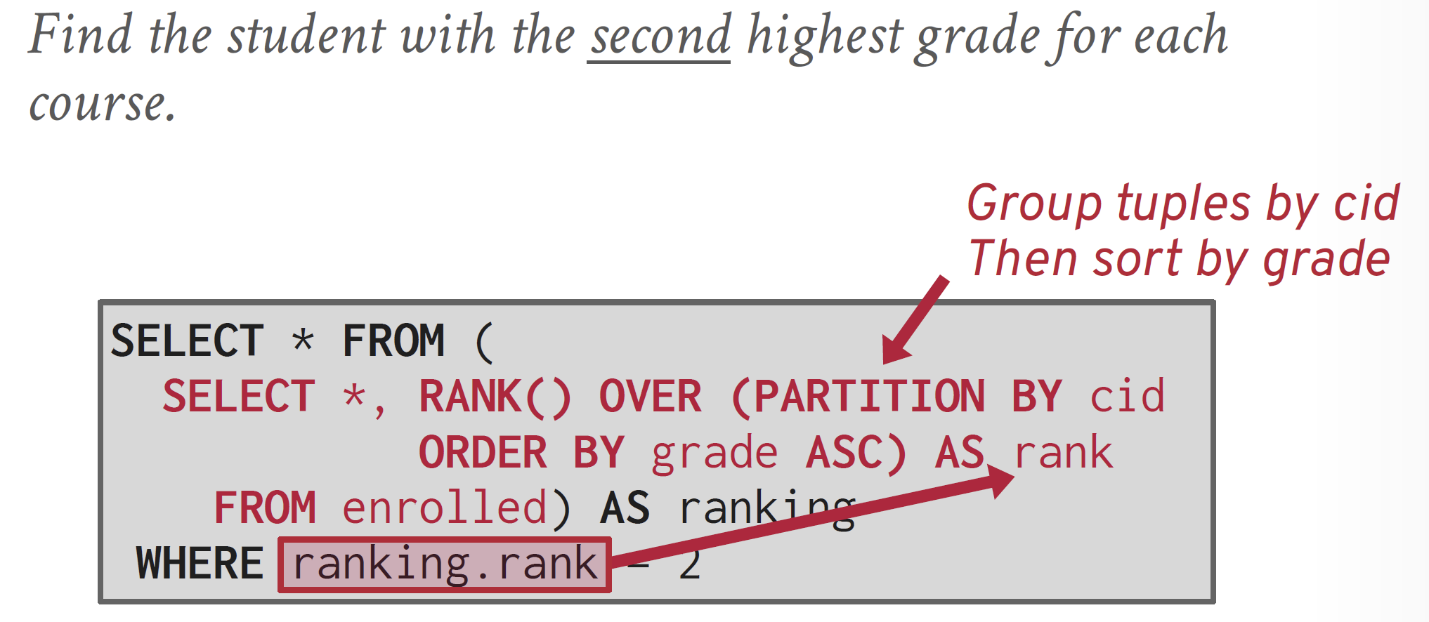
RANK
ROW_NUMBER() provides a unique number for each row, with no gaps.
RANK() provides the same rank for rows with the same values and introduces gaps in the ranking sequence after ties.

Slide 23
Subqueries
A subquery is an embedded SQL statement within an outer query.
The subquery provides an answer to the outer query in the form of a scalar value, a list of values, or a data set and may be substituted for an expression, list, or table, respectively, within the outer query.

Slide 24
Simple Subqueries
Simple subqueries are executed in the following order:
The simple subquery is executed once.
The results are passed to the outer query.
The outer query is executed once.
USE AdventureWorksLT2016;
SELECT pd.Name as ProductName
FROM SalesLT.Product pd
WHERE ProductCategoryID
IN (Select ProductCategoryID
From SalesLT.ProductCategory
Where Name = 'Cranksets');

Slide 25
Common Table Expressions
The common table expression (CTE) defines what could be considered a temporary view, which can be referenced just like a view in the same query.
The CTE uses the WITH clause, which defines the CTE. Inside the WITH clause is the name, column aliases, and SQL code for the CTE subquery.
After the CTE has been defined in the WITH clause, the main portion of the query can reference the CTE using its name as if the CTE were any other table source, such as a table or a view.
WITH cteQuery (ProductCategoryID)
AS (SELECT ProductCategoryID
FROM SalesLT.ProductCategory
WHERE Name = 'Cranksets')
SELECT Name AS ProductName
FROM SalesLT.Product p
INNER JOIN cteQuery c
ON p.ProductCategoryID = c.ProductCategoryID;

Slide 26
2 CTEs
WITH cteQuery1 (ProductCategoryID)
AS (SELECT ProductCategoryID
FROM SalesLT.ProductCategory
WHERE Name = 'Cranksets')
, cteQuery2 (ProductCategoryID)
AS (SELECT ProductCategoryID
FROM SalesLT.ProductCategory
WHERE Name = 'Lights')
SELECT Name AS ProductName
FROM SalesLT.Product p
INNER JOIN cteQuery1 c1
ON p.ProductCategoryID = c1.ProductCategoryID
UNION ALL
SELECT Name AS ProductName
FROM SalesLT.Product p
INNER JOIN cteQuery2 c2
ON p.ProductCategoryID = c2.ProductCategoryID

Slide 27
Recursive CTE
CTEs can be self-referencing, enabling it to be referenced multiple times in the same query.
Because it is self-referencing, it therefore creates recursion, thus a recursive CTE.
A recursive CTE is one in which an initial CTE is repeatedly executed to return subsets of data until the complete result set is returned.
WITH cte_numbers(n, [weekday])
AS (
SELECT 0, DATENAME(DW, 0)
UNION ALL
SELECT n + 1, DATENAME(DW, n + 1)
FROM cte_numbers
WHERE n < 6
)
SELECT [weekday]
FROM cte_numbers;

Slide 28
SUM
USE AdventureWorksLT2012;
SELECT pc.Name as ProductCategoryName,
SUM(OrderQty * UnitPrice) AS Sales
FROM SalesLT.SalesOrderDetail AS sod
INNER JOIN SalesLT.Product AS pd
ON sod.ProductID = pd.ProductID
INNER JOIN SalesLT.ProductCategory AS pc
ON pd.ProductCategoryID = pc.ProductCategoryID
GROUP BY pc.Name
ORDER BY Count(*) DESC;
GO

Slide 29
FOR XML
The FOR XML clause is a rowset aggregation function that returns a one-row, one-column result set containing an NVARCHAR(MAX) value.

Slide 30
FOR XML Example
SELECT
o.OrderNumber AS '@OrderNumber',
c.Name AS 'Customer/@Name',
i.ItemNumber AS 'LineItems/Item/@ItemNo',
od.Quantity AS 'LineItems/Item/@Qty'
FROM Orders o
INNER JOIN Customer c on o.customerID = c.customerid
INNER JOIN OrderDetail od on od.OrderID = o.OrderID
INNER JOIN Item i on i.ItemID = od.ItemID
FOR XML PATH('Order'), ROOT('Orders')

Slide 31
FOR XML Result
<Orders>
<Order OrderNumber="10001">
<Customer Name="Scott" />
<LineItems>
<Item ItemNo="V001" Qty="1" />
</LineItems>
</Order>
<Order OrderNumber="10002">
<Customer Name="Adam" />
<LineItems>
<Item ItemNo="A017" Qty="1" />
</LineItems>
...

Slide 32

Thank You & See You Again

